Slide 1
Improving Question-Answering Performance over Tabular Data with LangChain and LangSmith
By Harrison Chase

Slide 2
What is LangChain
Framework for building context-aware reasoning applications
Core, modular building blocks
Integrations with LLMs, vector stores, embedding models
Implementations of prompt templates, text splitters, agents, tools, memory, etc
End-to-end chains
Assembling these modular components for specific use cases

Slide 3
What is LangSmith
Platform for managing context-aware reasoning applications
Debugging, logging, monitoring
Testing, evaluation, datasets
All connected

Slide 4
The Problem
One big use case is question answering over tabular data
Most of the focus in the industry has been on unstructured data
Tabular data actually harder because it can have aspects of unstructured data but people also expect to be able to ask analytical questions
For a while, people had been asking for better support for this

Slide 5
The Solution
Collect Data
Define evaluator
Benchmark current solution
Experiment
Benchmark new solution
Repeat until satisfied

Slide 6
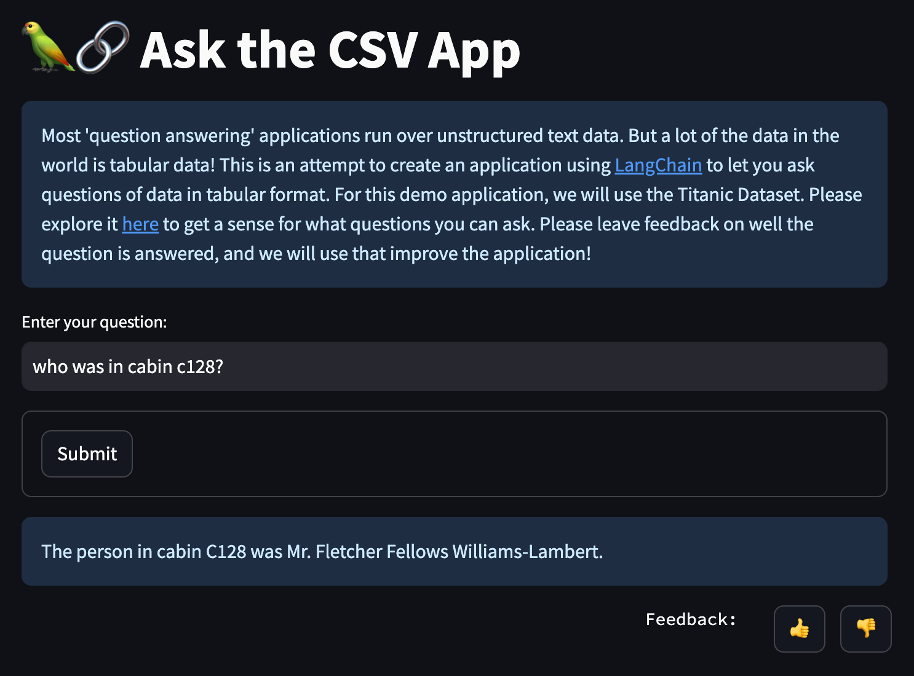
Collect Data

Slide 7
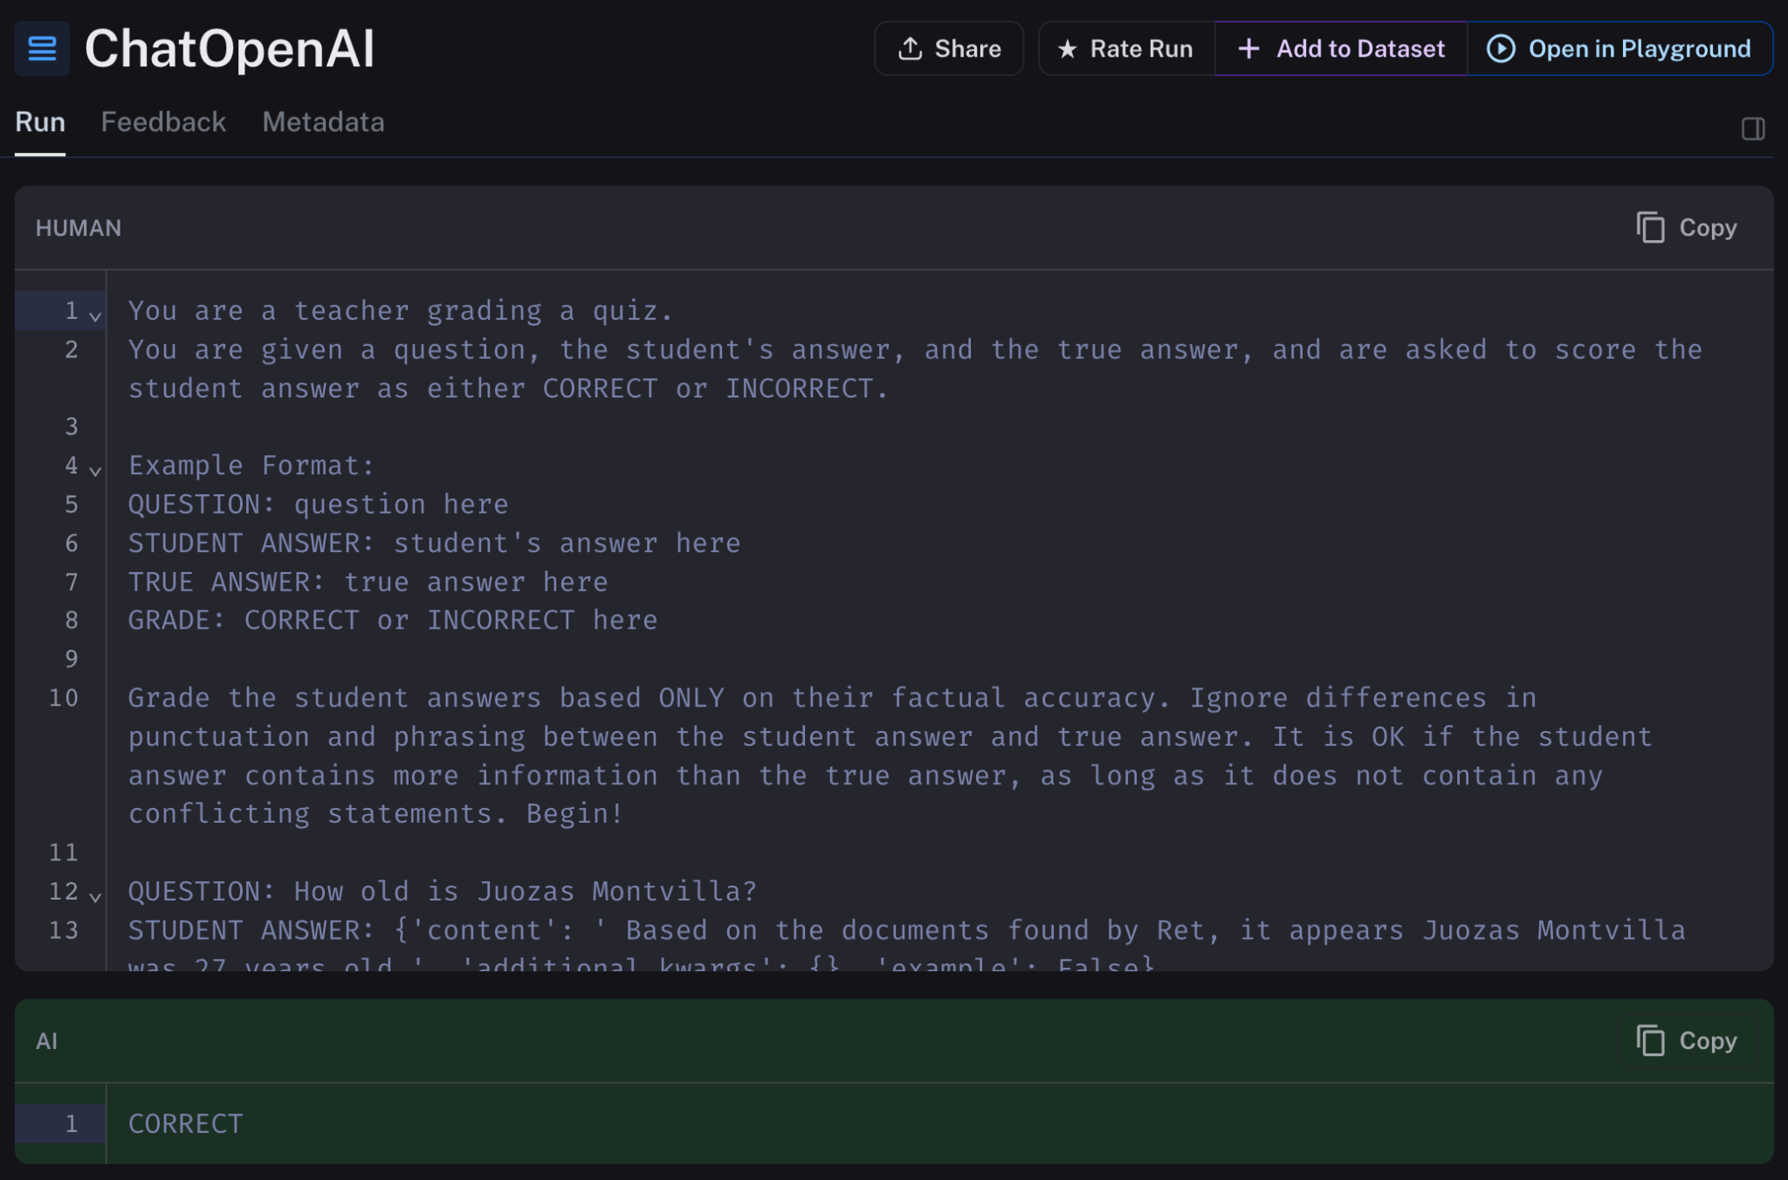
Define Evaluator

Slide 8
Old Solution
For CSV:
Pandas Agent (can write and run Pandas code)
For SQL:
SQL Chain (can write and run SQL)

Slide 9
Some Pain Points
Multihop questions
Questions about text columns
Even simple ones like name or song title
Multihop questions involving text columns
(sidenote) poorly formatted data

Slide 10
New Solution
Agent with multiple tools
Vectorstore - index over textual data
Pandas/SQL - perform analytic queries
Agent allows it to perform multiple steps
Really important for high cardinality textual columns!

